Slide 1

EE 402 – Senior Project II 2020 / 2021 FALL Fusion Sensor Project; Weather Effect on Object Detection Systems Berke Altındiş Naci Oytun Ozan Supervisor: Mehmet Parlak 23/01/2021

Slide 2
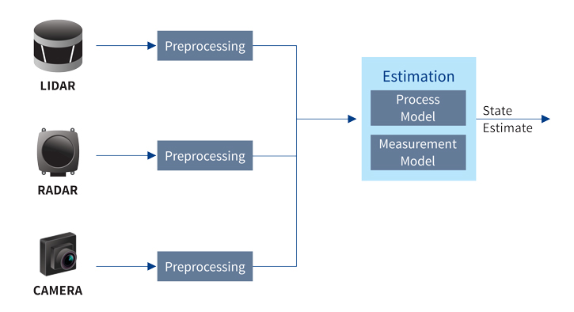
Introduction

Slide 3
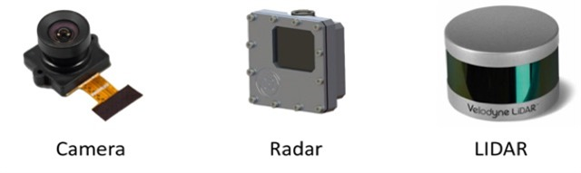
Fusion Sensor Project

Slide 4
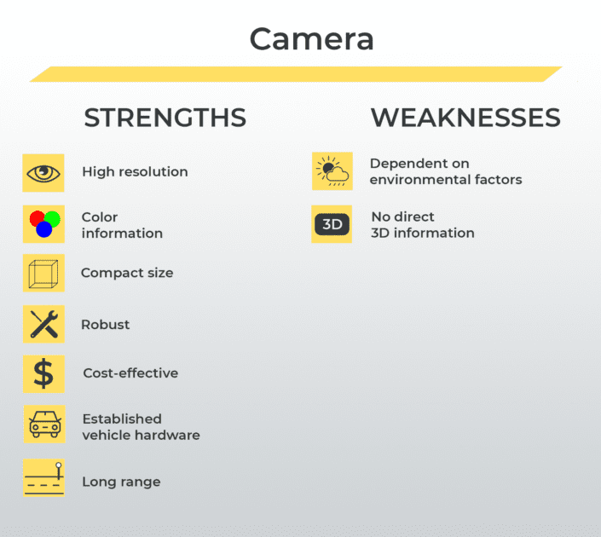
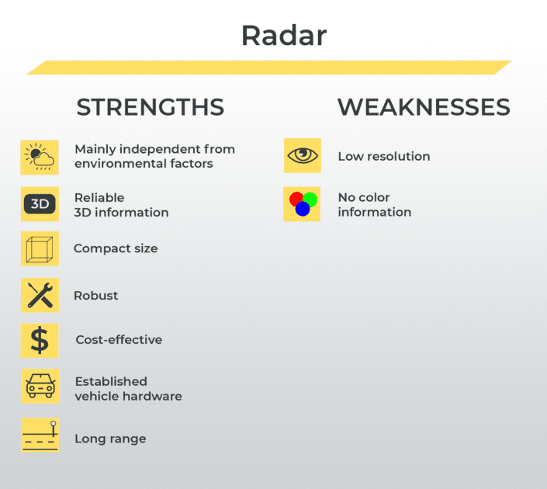
Camera vs Radar

Slide 5
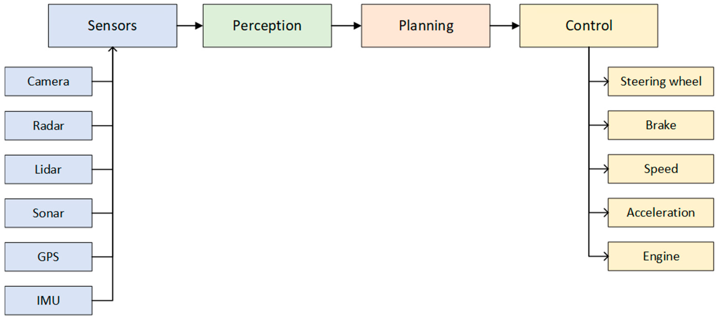
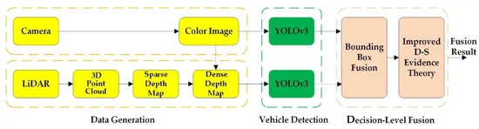
Block Diagram

Slide 6
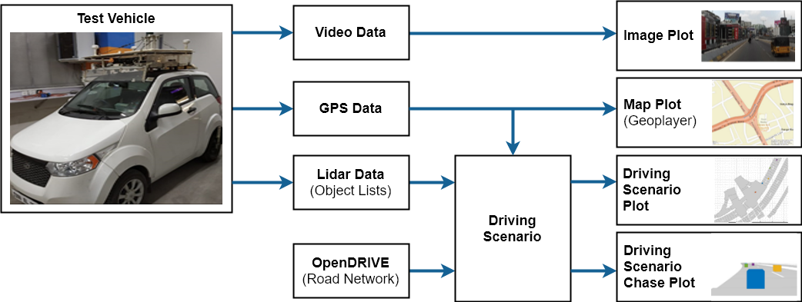
Block Diagram with Matlab Toolboxes

Slide 7
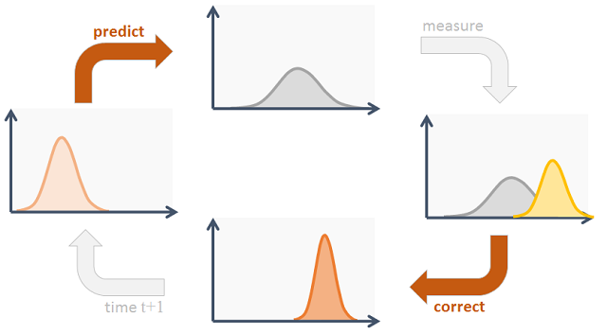
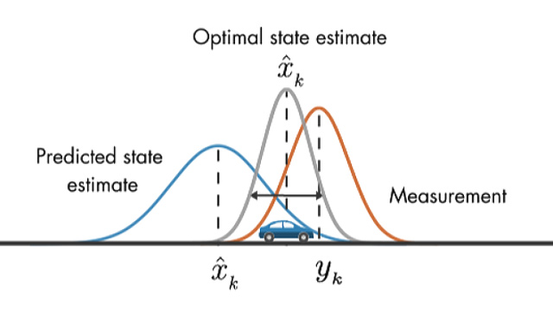
Kalman Filter

Slide 8
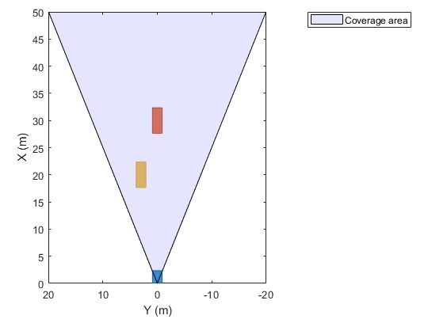
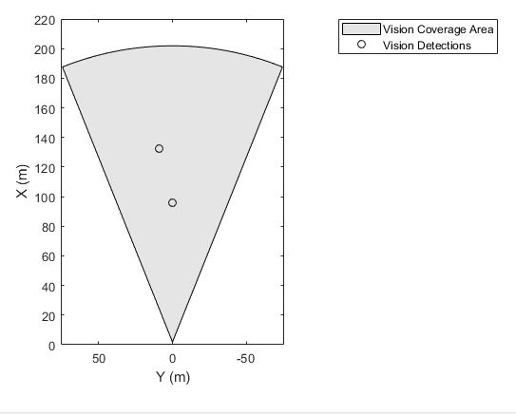
Implementation

Slide 9
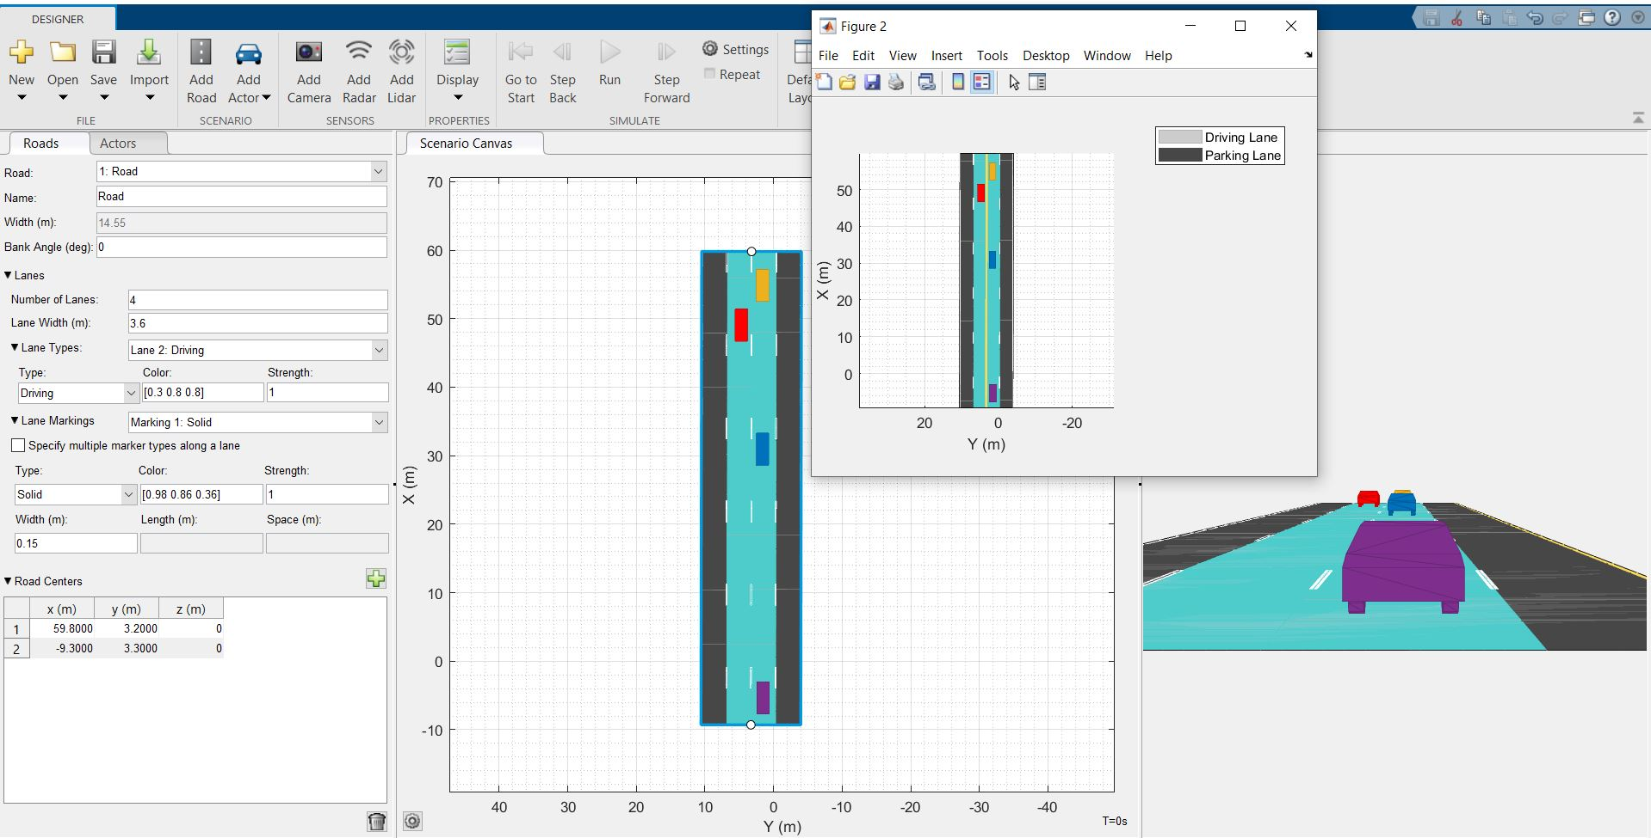
DrivingScenarioDesigner app
Create and define scenario
Fuse and track detections
from different sensors
Synthesize scenarios to test

Slide 10
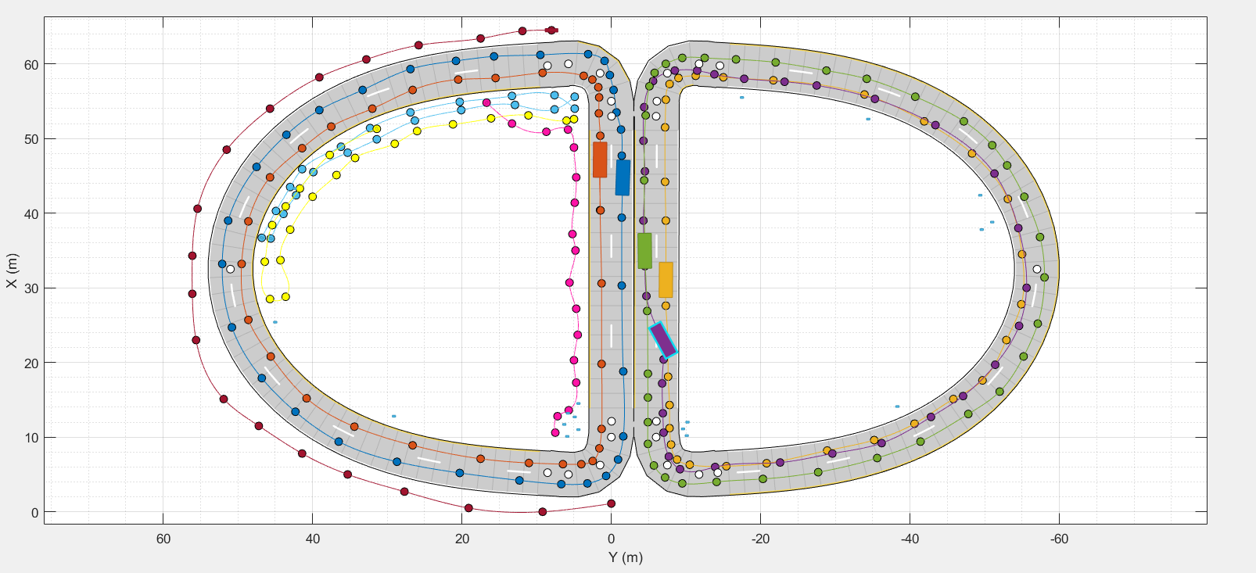
Designed Road

Slide 11
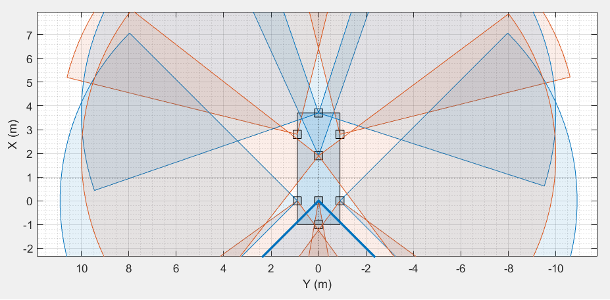
Sensor Placement

Slide 12
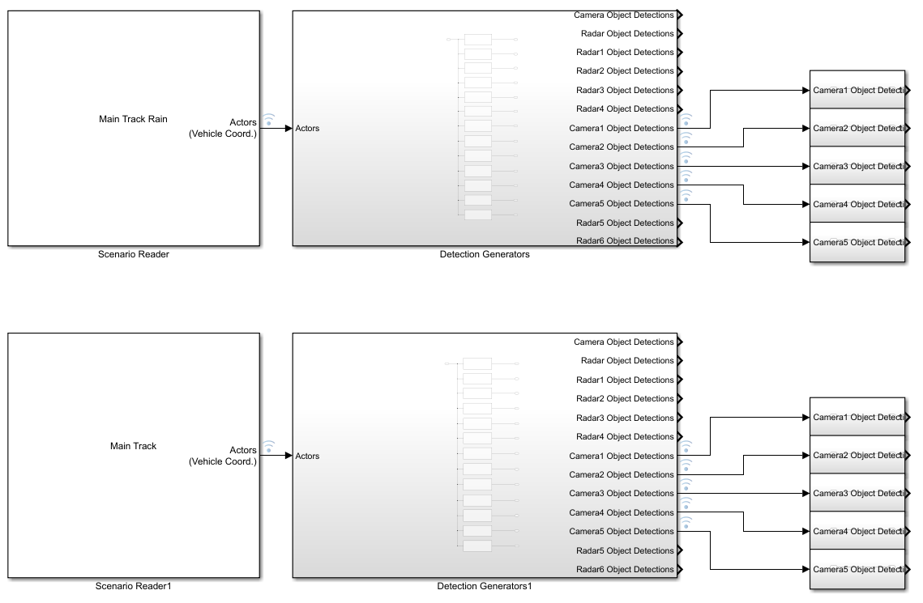
Simulink interface with scenario

Slide 13
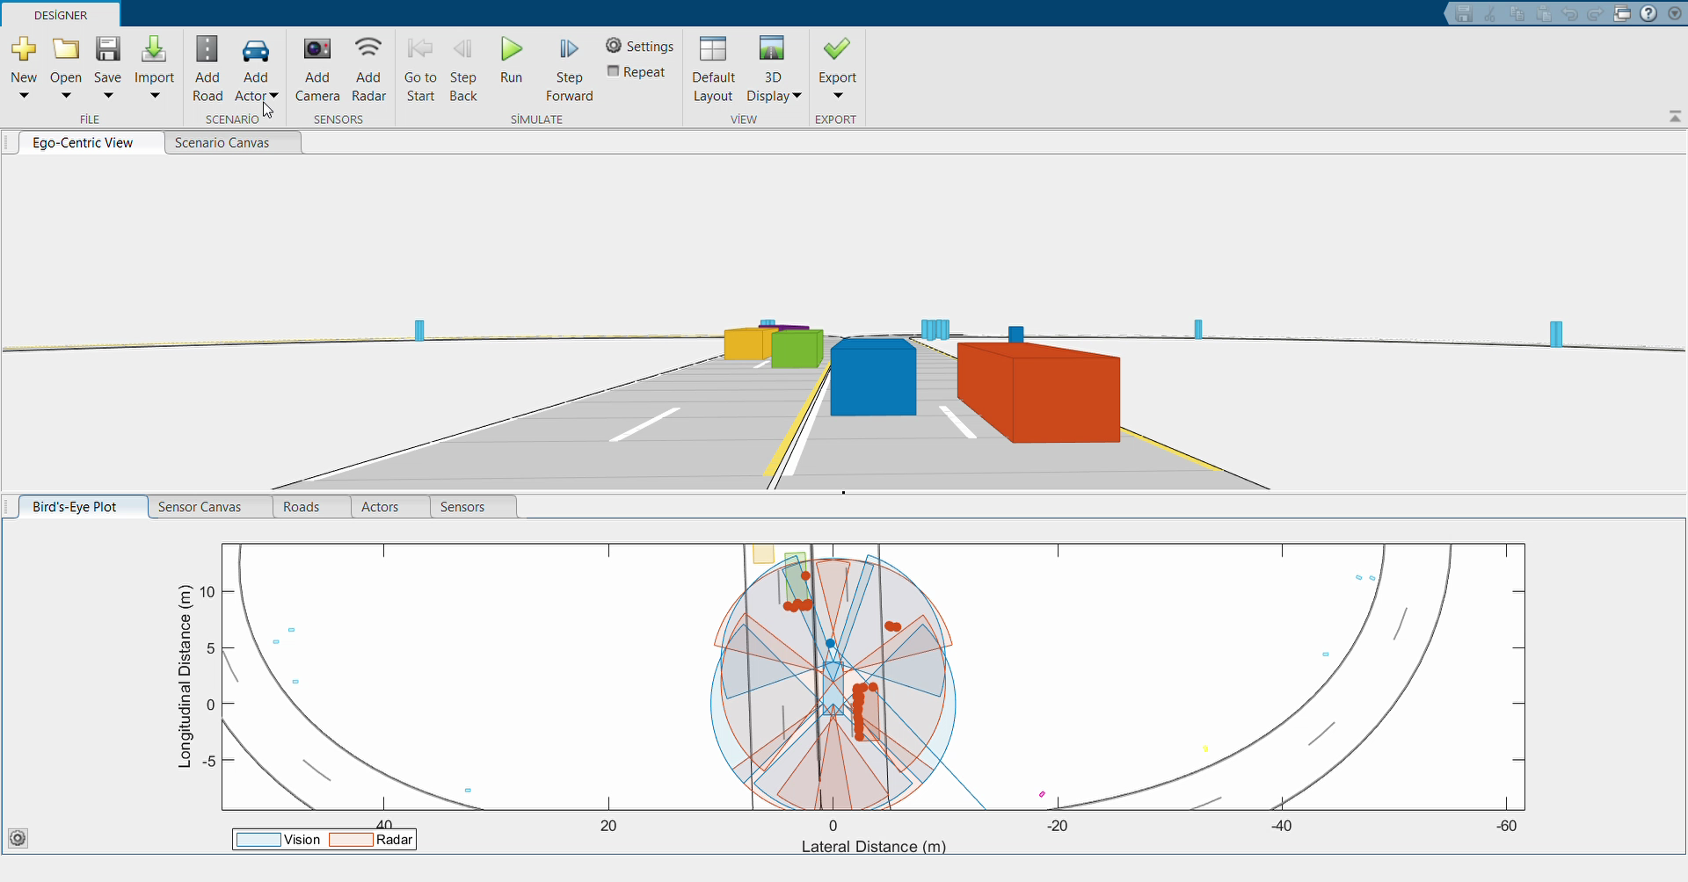
Matlab Video for Low Number Object

Slide 14
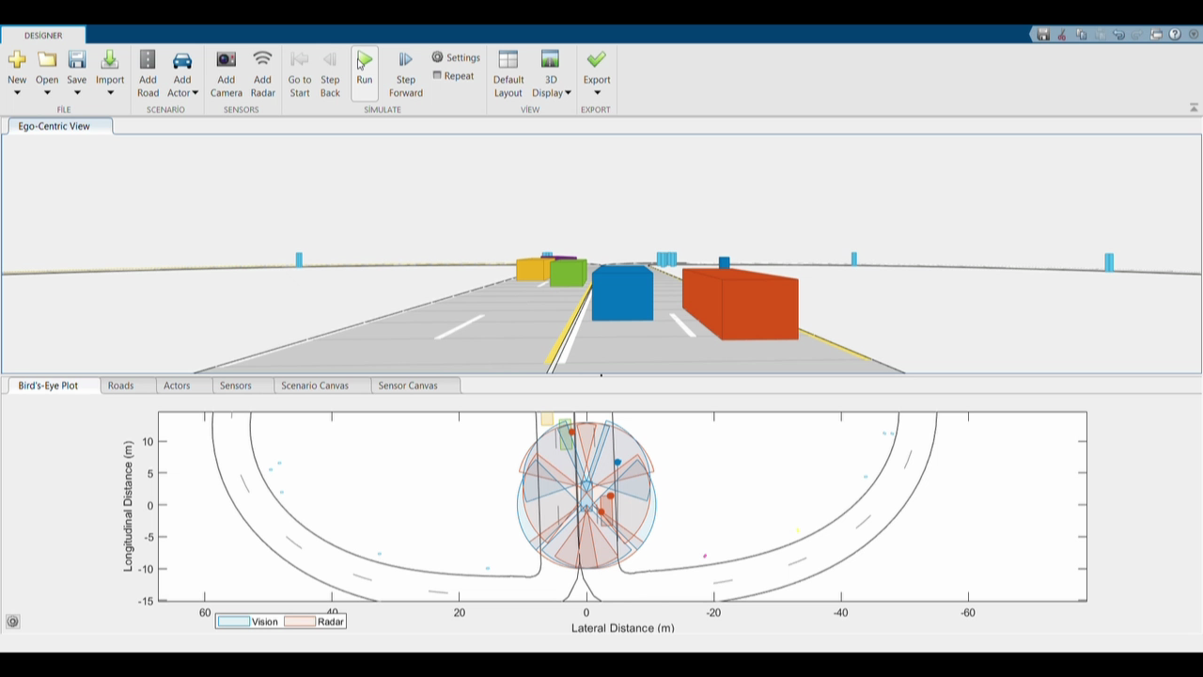
Matlab Video for High Number Object

Slide 15
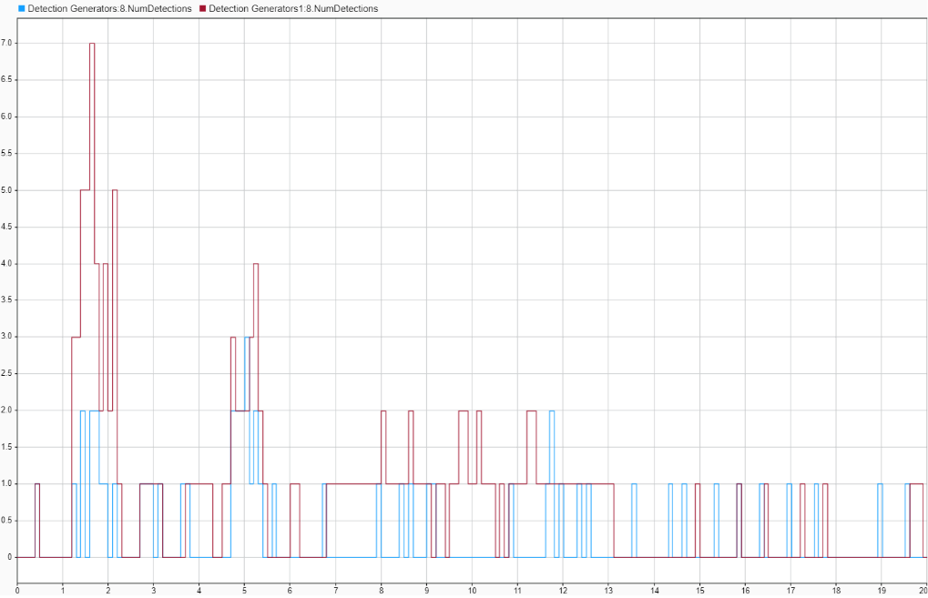
Camera 2 Data Outputs

Slide 16
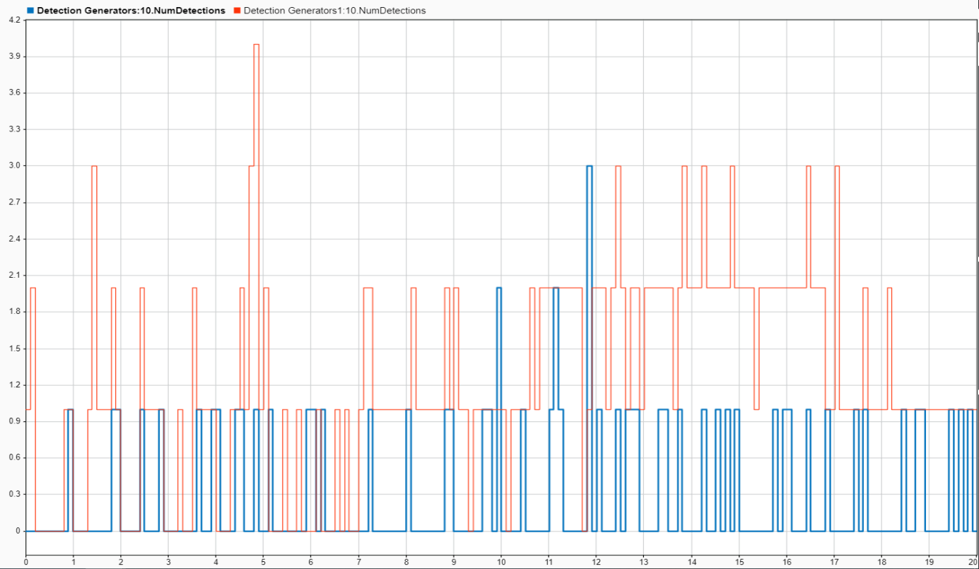
Camera 4 Data Outputs

Slide 17
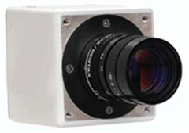
In Real Life Experience
2 megapixel MegaPlus Interline CCD Camera, High Frame Rate, 1920 x 1080 Pixel
Manufacturer: Princeton

Slide 18
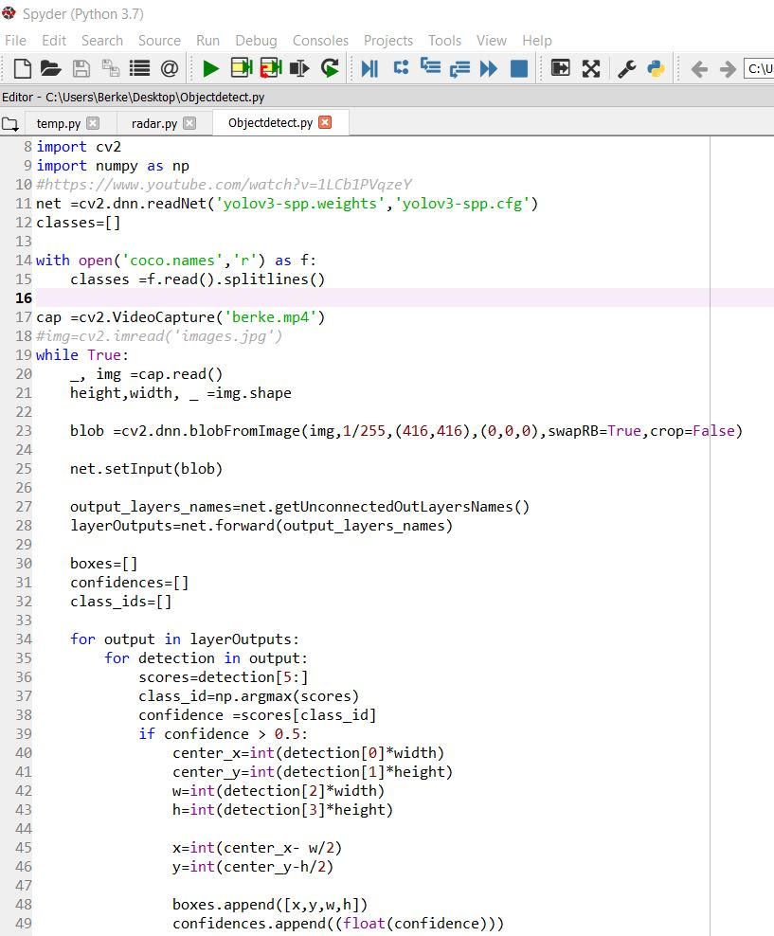
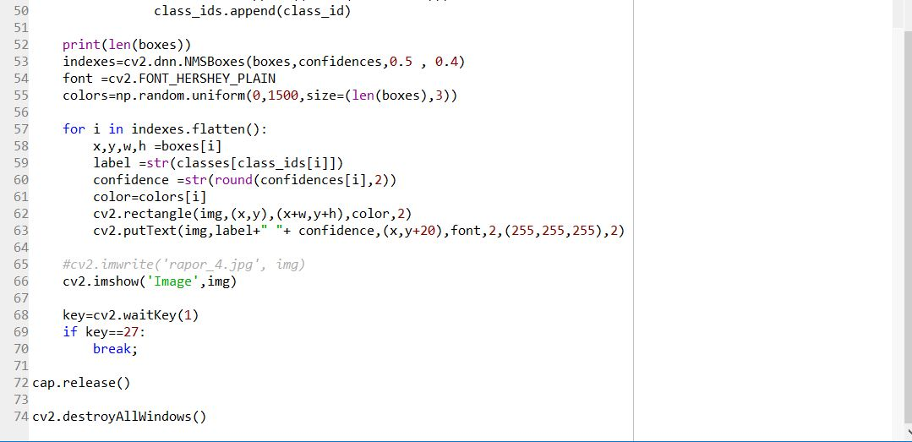
After Matlab, try on Python
Different than DrivingScenarioDesigner

Slide 19
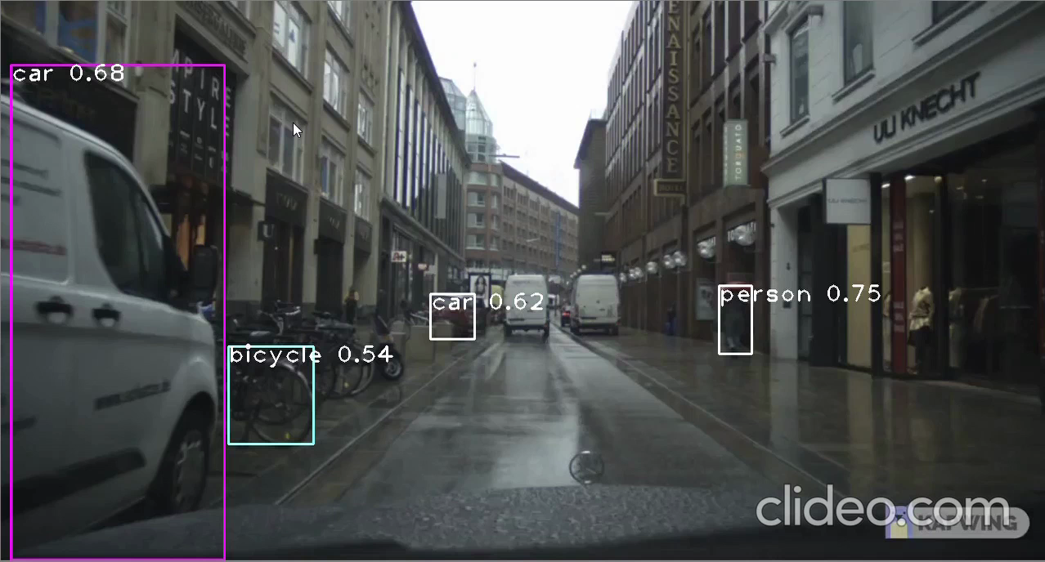
Python Video

Slide 20
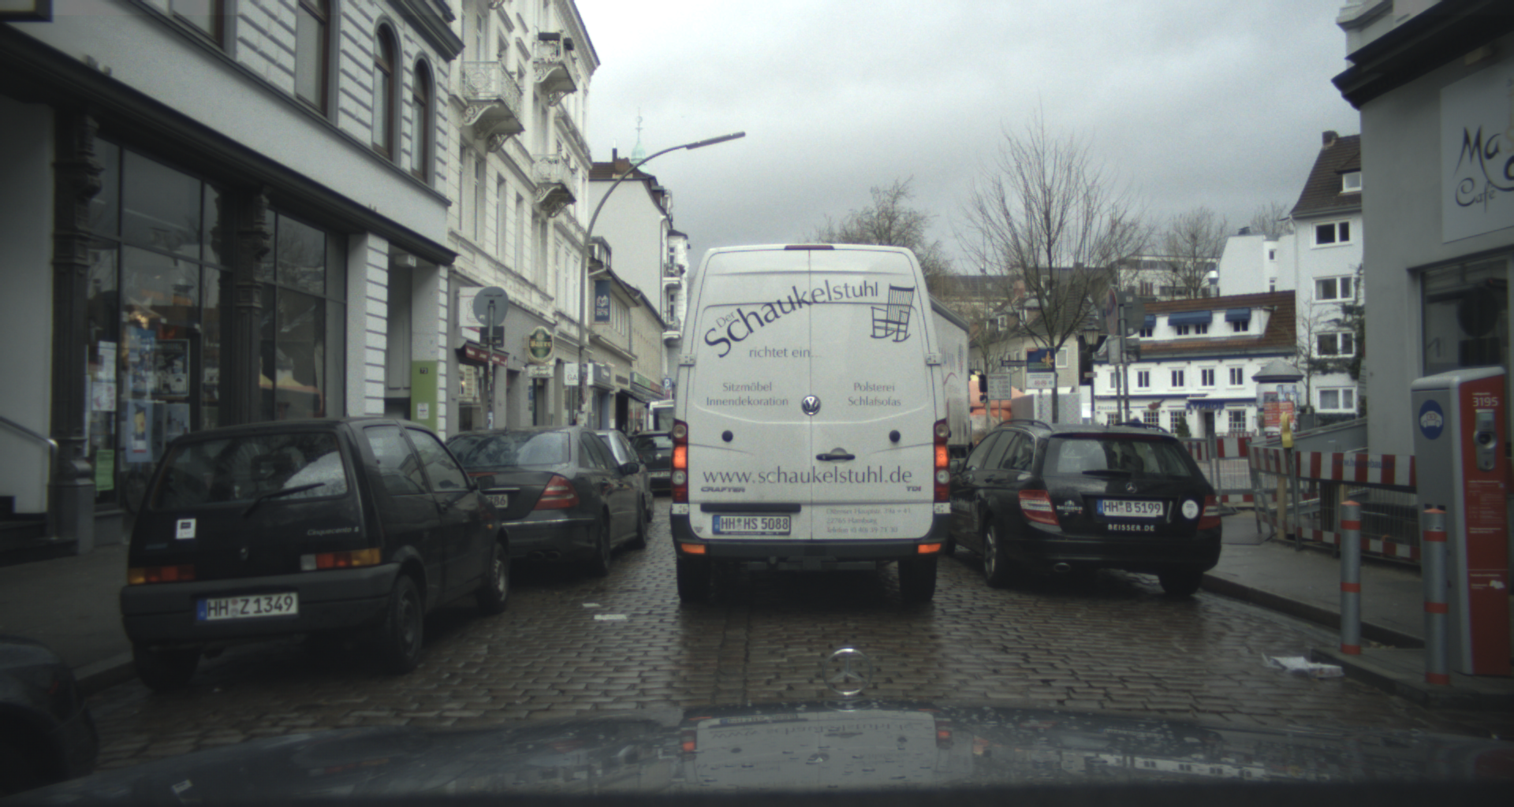
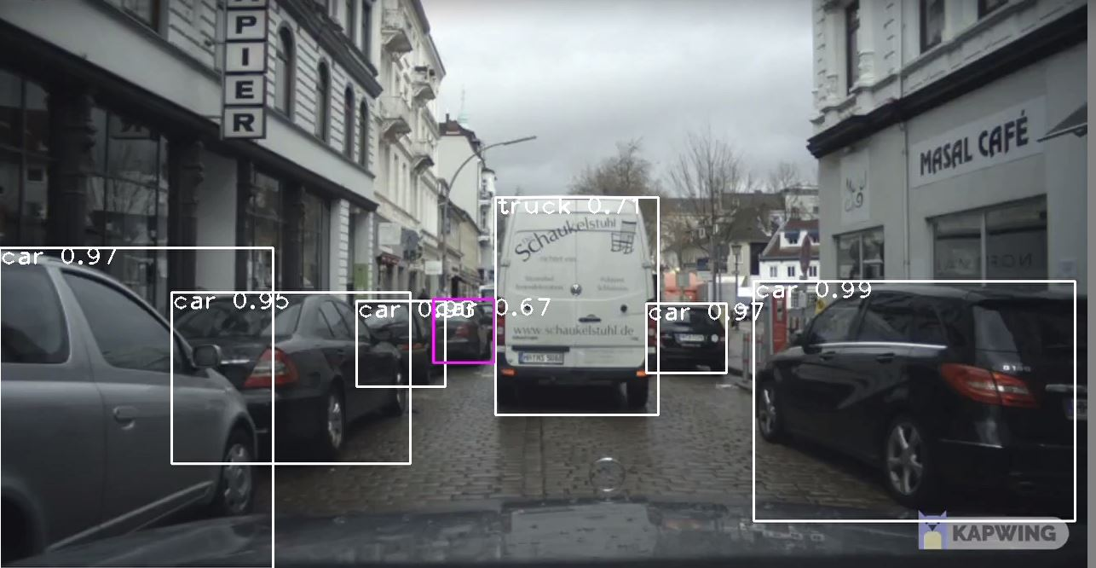
Object detection in rainy weather in Amsterdam

Slide 21
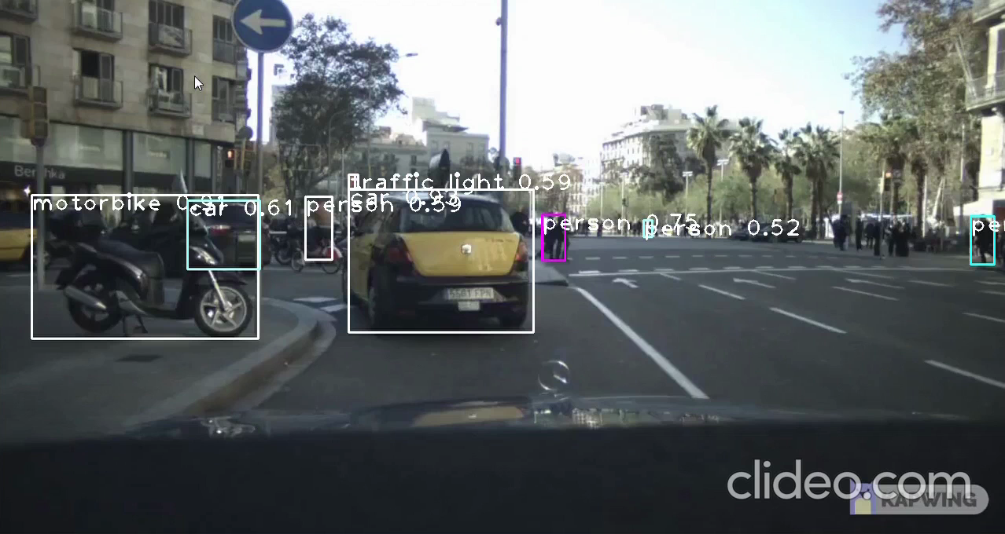
Python Video

Slide 22
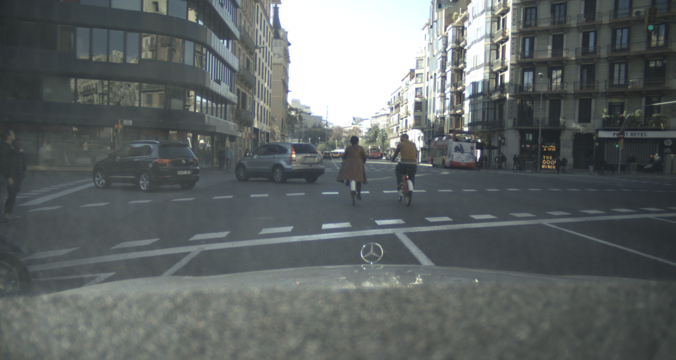
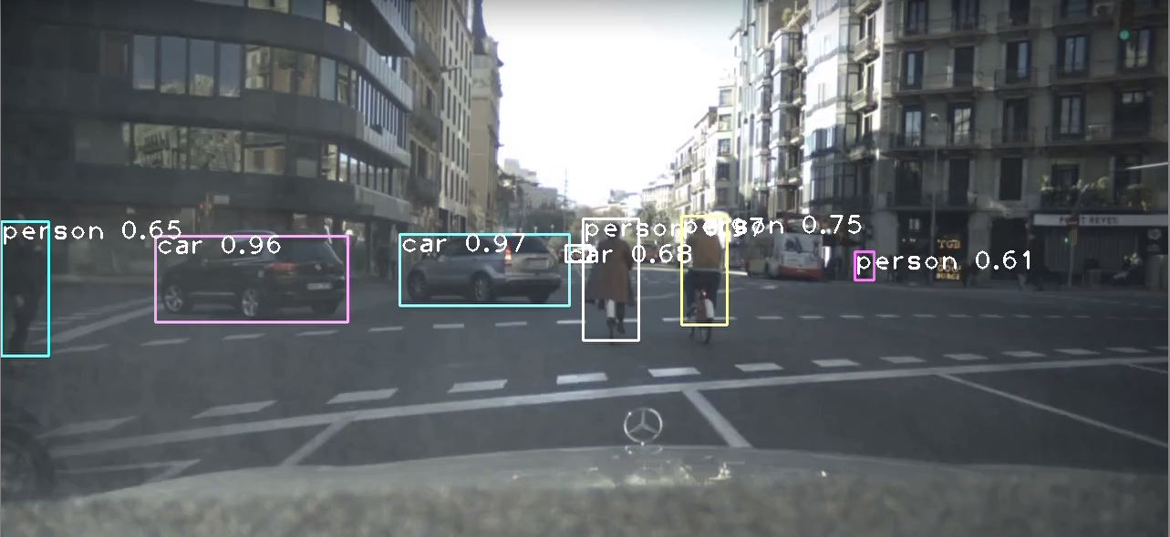
Object detection in sunny weather in Barcelona

Slide 23
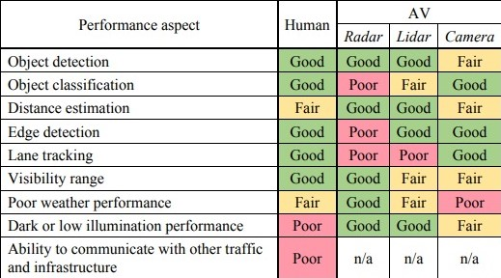
Conclusion and General Review

Slide 24

Q & A
Please feel free to ask any question.

Slide 25
Thank You For Listening.

